Slide 1

GLA UNIVERSITY, MATHURA
ENDLESS RUNNER
Bharat Shakya
Praveen Singh
Priyamesh Gupta
Utkarsh Chaturvedi
Vibhor Agarwal
Guided by:-
Mr. Divyansh Bhardwaj
Mr. Vaibhav Diwan

Slide 2
Why Game ?
Most Emerging Industry
Virtualization of thoughts
Passion and Intrest

Slide 3

THE GAME
The game title :-Endless runner
Target Age group 3+
The game is build for android.
The main game’s goal is to challenge player to run in endless run and collect coins, without hitting by obstacles.

Slide 4
In-game Tour
VIDEO

Slide 5
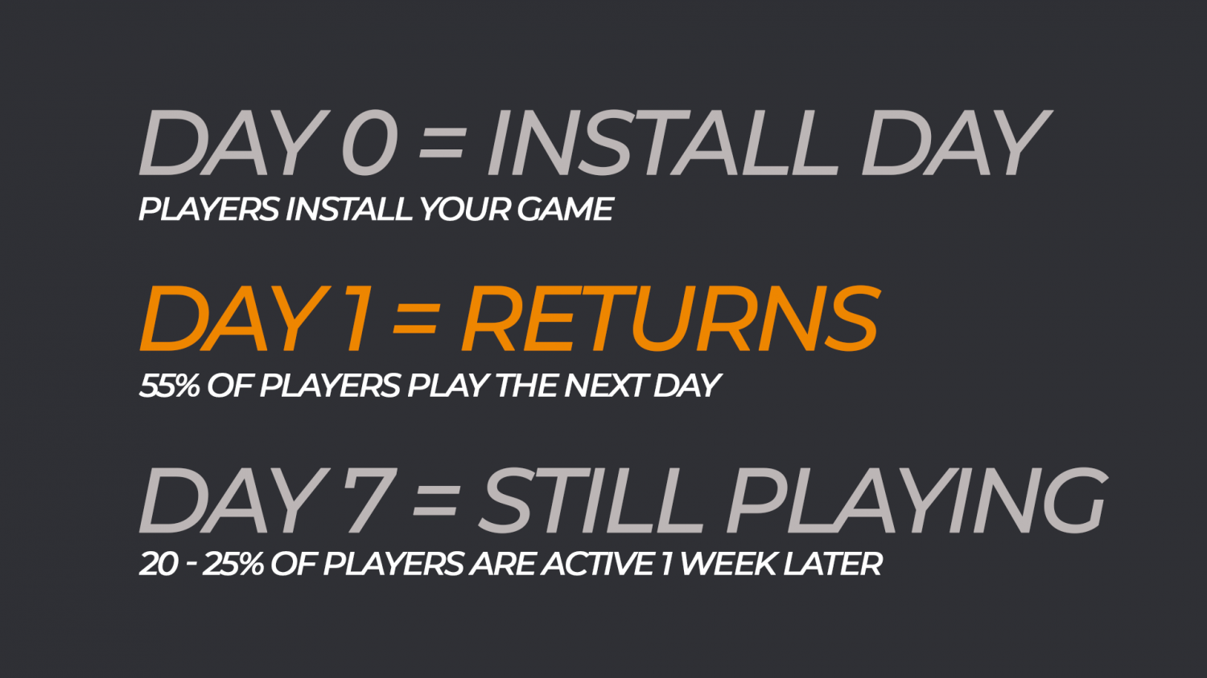
Game Retention Benchmark Metrics

Slide 6
FUTURE ASPECTS
The Game is to be published on Play store and Apple store.
Various themes is to be added.
Gameplay enhancement .

Slide 7
MAKING MONEY
Monetising the game:-
Interstitial Ads – Full screen pop up ads typically shown on Game over screens.
Rewarded Videos – Used to reward players by gifting Coins, Lives, Level Unlocks, Characters etc.
In App Purchases – For Hyper Casual games be sure to include a “Remove Ads” consumable IAP at least.
Sponsorship – Team up with Influencers or Brands for an Epic Partnership.

Slide 8
In-Game Updates
Sound effects can be added.
More obstacles can be added.
Database can be added to store data.
Several other short time add-ups can be added.

Slide 9
THANK YOU

